Slide 1

Overview of Orange HRM project and glance of my tasks

Slide 2
Agenda
Project Overview
Project Description
Glance of my task
Test Cases
Test cycle & Regression Suite
Test Plan
Bugs

Slide 3

Project Overview
It is Human Resource Management (HRM) application developed on
PHP
My SQL Database
Apache HTTP Servers
It can be used in
Linux Environment
Microsoft Windows Environment
URL: https://opensource-demo.orangehrmlive.com/web/index.php/auth/login

Slide 4
Project Description
My Info Module is a powerful tool providing employees of the company with the ability to view relevant information such as personal information and updating personal information with an internet enabled PC without having to involve the HR department.
The functionality of this module spans through the entire system, making information available anywhere, anytime. All information is subject to the company's defined security policy, where he/she can only view the information he/she is authorized to.
An ESS-User can only edit certain fields in the ESS Module, maintaining the security and confidentiality of employee information.

Slide 5
The module consists of 11 sections
My Info Module
Photograph
Contact Details
Emergency Contact
Dependents
Immigration
Job
Salary
Report To
Qualifications
Membership.
I have worked on Contact details section under my my info.

Slide 6
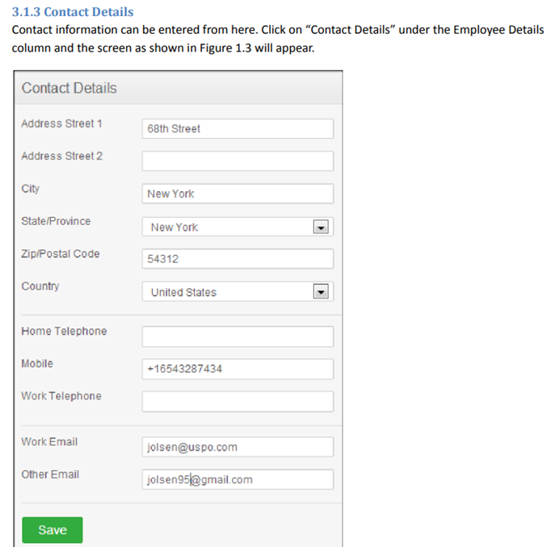
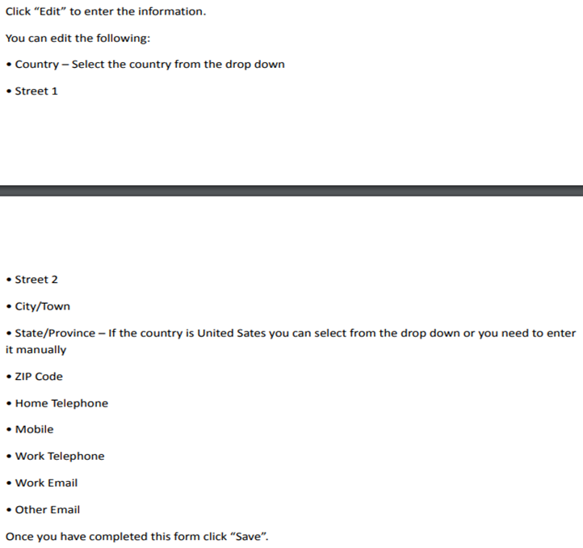

SRS
Hi there

Slide 7

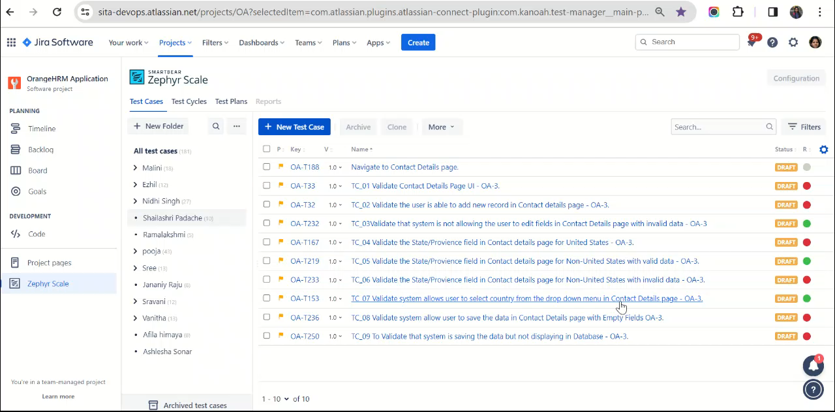
Test Cases

Slide 8

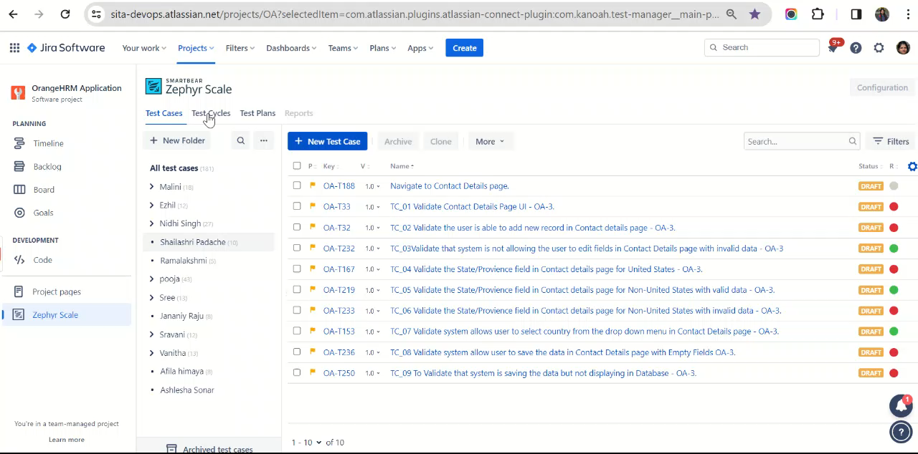
Test Cycle and Regression Suite

Slide 9
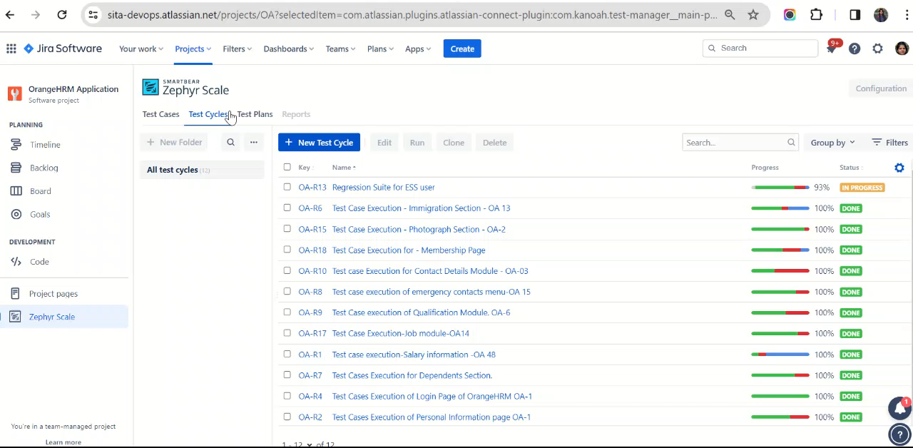
Test Plan

Slide 10
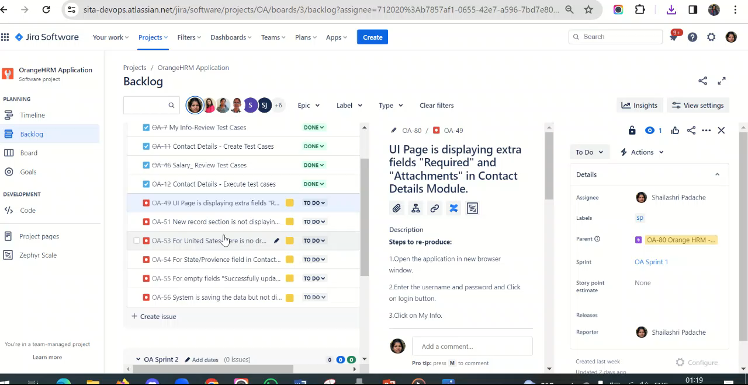
Bugs

Slide 11

Thank You

